Slide 1
Data Protection Notice
The Network for East Anglian Collaborative Outreach (neaco) is a project aimed at increasing the number of young people going into Higher Education. neaco consists of the University of Cambridge (including its Colleges), Anglia Ruskin University, the University of East Anglia, Norwich University of the Arts, and the University of Suffolk.
Take Your Place is the programme which is being run by neaco in schools and colleges in East Anglia. Information about how your personal information will be used by us in connection with the administration of the Take Your Place programme, and for related purposes, is available at https://www.takeyourplace.ac.uk/how-we-use-participant-data.
We will also get in touch by email to facilitate your involvement in the Take Your Place programme. Please contact info@takeyourplace.ac.uk if you have any questions about how we use your data.
Explore your options,
Discover your potential
takeyourplace.ac.uk

Slide 2
Explore your options,
Discover your potential
Preparing for a Geography application
Developing your learning in Geography
takeyourplace.ac.uk

Slide 3
How can we help?
This PowerPoint is here to provide you with different ideas to help and support you with writing a Personal Statement for a Geography course, plus the application process.
We have put together reading lists, preparation ideas and top tips for the application process for a Geography course at a university.

Slide 4
Where do I start?!
Let’s start with some reading. We recommend using this time to do some further reading on your chosen subject, as it is important that your personal statement contains an academic paragraph.

Slide 5
An Academic Paragraph
Having an academic paragraph in your personal statement is really important and we suggest using the following reading lists to help. You can use this paragraph to analyse a particular part of the study of Geography that you are fascinated by.

Slide 6
Reading Suggestions
General reading
A good starting point is reading geography magazines. Try:
Geographical Magazine
National Geographic
Your school library may have a subscription for these magazines – try there first!

Slide 7
Reading Suggestions
Blood River: A Journey to Africa’s Broken Heart (Tim Butcher)
This Changes Everything: Capitalism vs the Climate (Naomi Klein)
Powerdown: Options and Actions for a Post Carbon World (Richard Heinberg (2004))
The New Rulers of the World (John Pilger)
The White Tiger (Aravind Adiga)
The Debt Boomerang (Susan George)
No One Is Too Small To Make A Difference (Greta Thunberg)
An Inconvenient Truth (Al Gore)
Natural Disasters (David Alexander)

Slide 8
Reading Suggestions
•Green Development: environment and sustainability in the Third World (Adams, W.M.)
•Poverty and Development into the 21st Century (Allen, T. and Thomas, A.)
•Making Development Geography (Lawson, V.)
•Blood Diamonds: Tracing the Deadly Path of the World's Most Precious Stones (Campbell G.)
•The Day after Tomorrow (Whitley Strieber)
•Touching the Void (Joe Simpson)
•Ecology of Fear (Mike Davis)
•Gaia, a new look at life on Earth (James Lovelock)

Slide 9
Reading Suggestions
•Coasts and Coastal Management (Hill, M.)
•Hazards (Skinner, M.)
•Hazards and Responses (Bishop, V.)
•Nature of the Environment (Goudie, A.)
•Rivers and Water Management (Nagle, G.)
•Tsunami (Tibballs, G.)

Slide 10
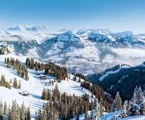
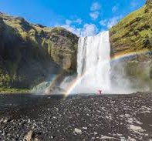
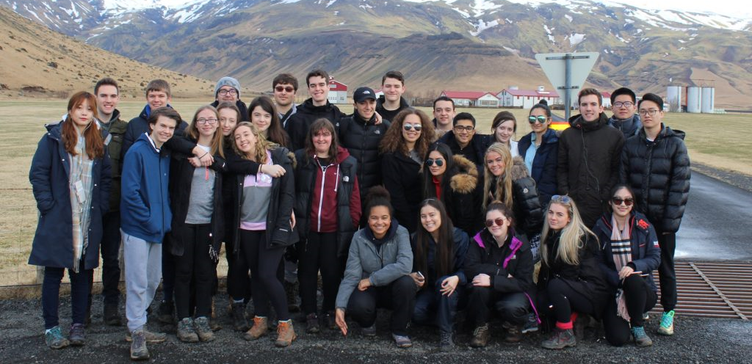
What else can I talk about?
You can also write about any geographical trips you have been on. Perhaps a trip was the reason for your passion in Geography. You could show how your passion has developed.

Slide 11
Watch
•News programmes: http://www.channel4.com/news/
•Newsnight: http://www.bbc.co.uk/programmes/b006mk25
•Andrew Marr Show: http://www.bbc.co.uk/programmes/b0080bbs
•TED talks: https://www.ted.com/talks•Planet Earth: https://www.google.co.uk/#q=planet+earth+2
•Cool Geography animations:http://www.coolgeography.co.uk/advanced/water_carbon_cycles.php

Slide 12
Take part
Visit the National History Museum
Attend National Geographical Society talks/events
Visit your local library and discover more about the geography of your local area. There may be a local group of geography enthusiasts already out there!
Have you thought about setting up a Geographical Society at your sixth form?

Slide 13
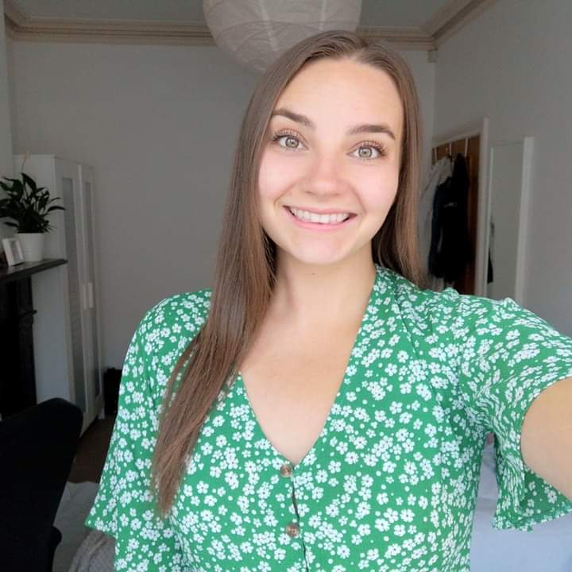
Ellie Hope BA (Hons) Geography Coventry University
Ellie’s personal statement tips:
Tutors read so many personal statements – make yours as interesting as possible! Try not to just list everything you have done – that gets boring fast.
Be specific – they already know you’re interested in Geography because you’re applying, but what topics specifically are you interested in? Use your time away from school to research and find out!
Everyone will be studying Geography at A-level – what are you doing differently? Show that you’re passionate enough about the subject to read and learn beyond school. There’s lots of access to free resources online through websites like National Geographic or the Royal Geographic Society. Going to university is such a change from A-levels and you have to be independent so even something simple like researching a topic online shows initiative and the ability to work independently.
Transferable skills – you don’t have to talk about everything geographical, Geography has a lot of transferable skills so things you’ve in other subjects or through a job are relevant too.

Slide 14
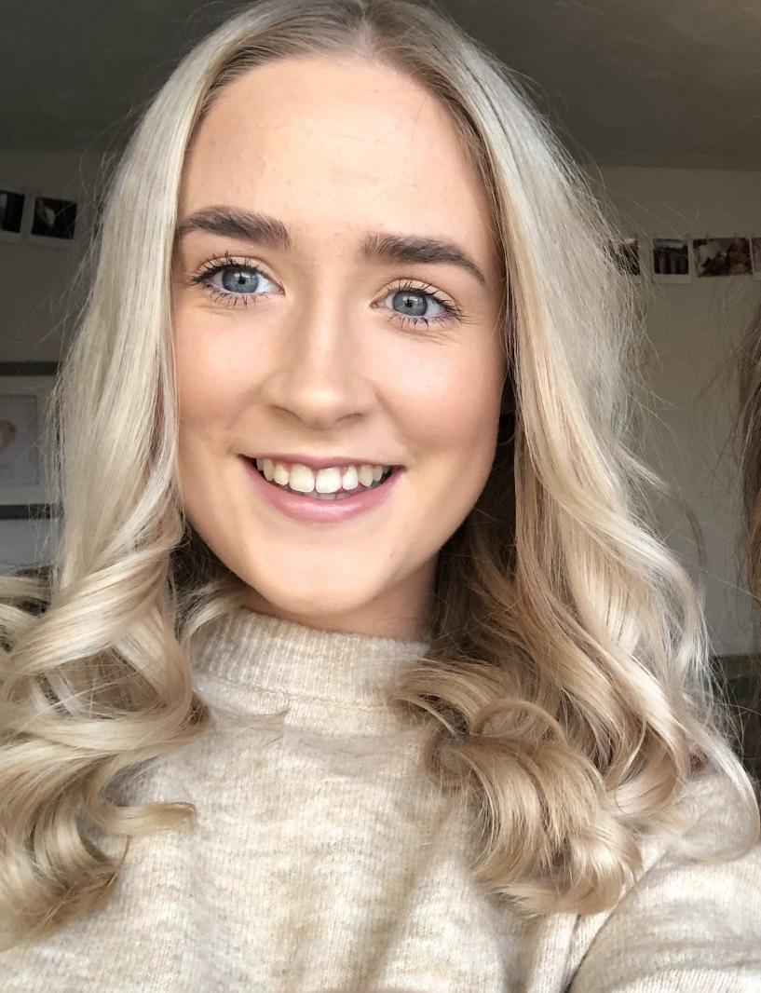
Megan Charlton BSc Geography University of Nottingham
Megan’s personal statement tips:
Advice for lockdown in preparing for uni is - Do your research!! if you've made a decision about which few university's you are interested in then look at the course in more detail, email any academic staff if you want more information as they are always happy to help and look at the accommodation and dates that you need to apply! Facebook groups/pages (when you know which university your firm/insurance choice is) are very useful in finding out information and chatting to people interested in the same course, you may even make some friends before you get there!
Aim high - if you want to achieve certain grades and your teachers support this, then it’s likely you will.
Make sure you have an insurance choice you are happy with and would also love to go to - rather than a course with very low grades, as clearing is always an option.
In terms of life at uni - you get out of it what you put in. the harder you work and the more you read and speak to the academic staff the more you will learn and understand. Its daunting at the start trying to put yourself out there and make friends but you will find people through your course, halls and societies.

Slide 15
My HE+
Thinking about applying to University and looking for ways to explore your subject beyond the curriculum? Then this website is for you. Each topic is produced by Cambridge postgraduate students and academics at the cutting edge of research in their field. The topics provide guided activities, questions to think about and suggestions for further reading.
The main subject pages also give you a quick guide to what it would be like to study the subject at university level and suggest some further resources to check out.
https://www.myheplus.com/

Slide 16
Online Courses
FutureLearn - Explore online courses to continue studying,
build professional skills and connect with experts.
Useful examples include:
How to Succeed at: Writing Applications
How to Succeed at: Interviews
OpenLearn - Open University? – These courses have been designed to increase confidence and develop the skills needed to enter Higher Education and succeed with learning.
The courses are free and they do not have a start and end date. You can start right away or at a time that suits you.
You can spend as long as you like on an OpenLearn course, plus, if you sign up you can track your progress and work towards a statement of participation.
There are around 1000 courses to choose from - https://www.open.edu/openlearn/free-courses/full-catalogue

Slide 17
Find Us Online:
www.TakeYourPlace.ac.uk
Cambs@TakeYourPlace.ac.uk
https://www.facebook.com/TakeYourPlaceHE
@TakeYourPlaceHE
@TakeCambs

