Slide 1


Data Protection Notice
The Network for East Anglian Collaborative Outreach (neaco) is a project aimed at increasing the number of young people going into Higher Education. neaco consists of the University of Cambridge (including its Colleges), Anglia Ruskin University, the University of East Anglia, Norwich University of the Arts, and the University of Suffolk.
Take Your Place is the programme which is being run by neaco in schools and colleges in East Anglia. Information about how your personal information will be used by us in connection with the administration of the Take Your Place programme, and for related purposes, is available at https://www.takeyourplace.ac.uk/how-we-use-participant-data.
We will also get in touch by email to facilitate your involvement in the Take Your Place programme. Please contact info@takeyourplace.ac.uk if you have any questions about how we use your data.
Explore your options,
Discover your potential
takeyourplace.ac.uk

Slide 2
Explore your options,
Discover your potential
Preparing for a Chemistry Application
takeyourplace.ac.uk

Slide 3

How can we help?
This PowerPoint is here to provide you with different ideas to support you with writing a Personal Statement for a Chemistry course, as well as help you through the application process.
We have put together reading lists, preparation ideas and top tips for the application process for a Chemistry course at University

Slide 4

Where do I start?!
Lets start with some reading. We recommend using this time to do some further reading on your chosen subject, as it is important that your personal statement contains an academic paragraph.

Slide 5
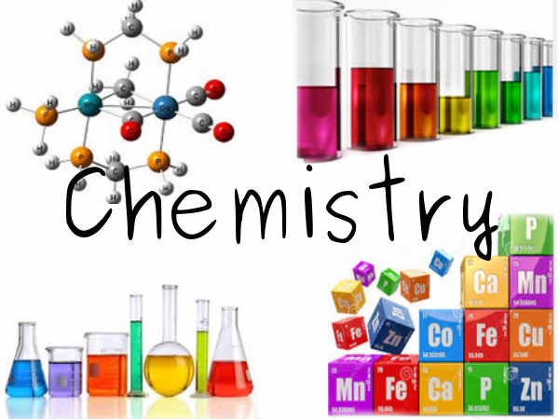
An Academic Paragraph
Having an academic paragraph in your personal statement is really important and we suggest using the following reading lists to help. You can use this paragraph to analyse a small piece of text from a relevant book/journal or an article.

Slide 6

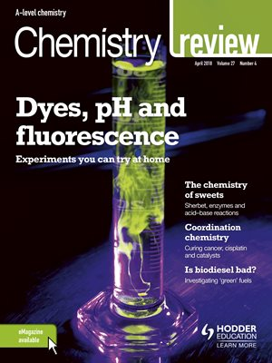
•BBC science and technology website: http://www.bbc.co.uk/science
•BBC news: http://www.bbc.co.uk/news/science_and_environment
•The Guardian - https://www.theguardian.com/science
•New Scientist: https://www.newscientist.com/
Physics journals
•Chemistry Review:
https://www.hoddereducation.co.uk/chemistryreview
•The Mole: http://www.rsc.org/eic/mole
•
Reading Suggestions

Slide 7

Reading Suggestions
Books
•A Short History of Nearly Everything by Bill Bryson
•Surely You're Joking, Mr Feynman! by Richard Feynman
•Bad Science by Ben Goldacre
•Oxygen: The Molecule that Made the World by Nick Lane
•Mauve: How One Man Invented a Color that Changed the World by Simon Garfield (The story of the first man who made a useful chemical and started the entire industry of synthetic organic chemistry.)
• Periodic Tales, the Curious Lives of the Elements by Hugh Aldersey Williams
•Why Chemical Reactions Happen by James Keeler and Peter Wothers
•Molecules at an Exhibition: Portraits of Intriguing Materials in Everyday Life by John Elmsley
•Napoleon’s Buttons: 17 Molecules that Changed History by Le Couteur & Burreson
•Uncle Tungsten: Memories of a Chemical Boyhood by Oliver Sacks
•The Science of Everyday Life: Why Teapots Dribble, Toast Burns and Light Bulbs Shine by Marty
Jopson
•The Disappearing Spoon...and other true tales from the Periodic Table by Sam Kean

Slide 8

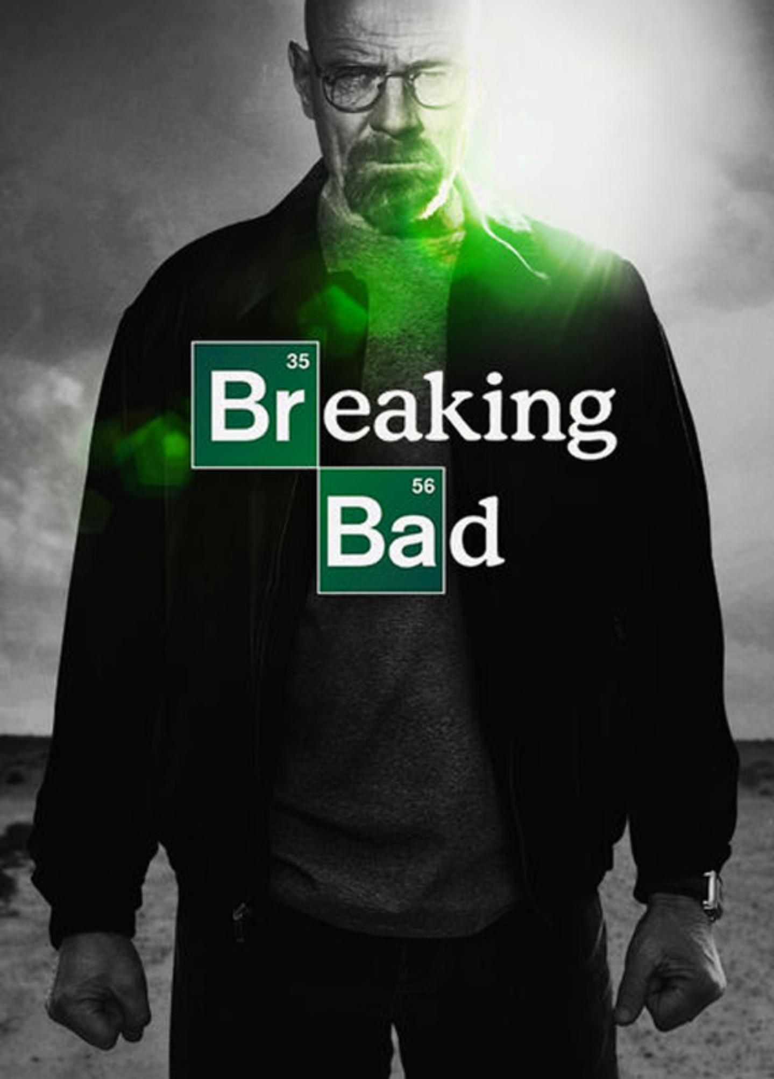
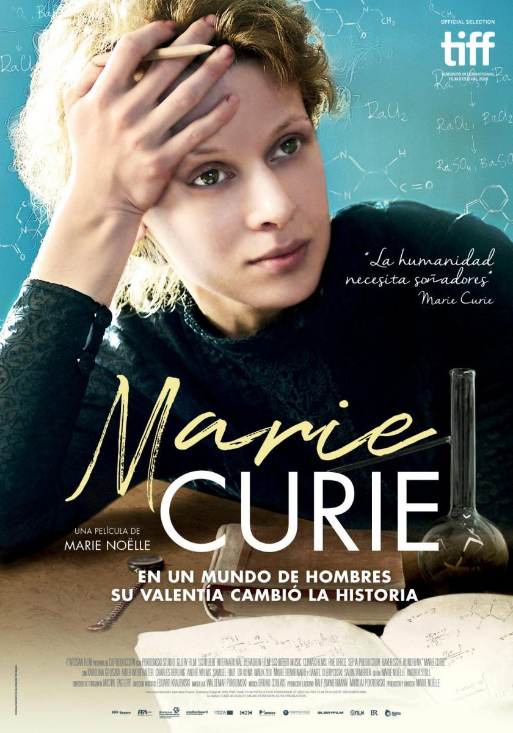
WATCH
•TED talks on https://www.ted.com/talks
•Khan Academy website for online lectures:
https://www.khanacademy.org/science
•Science Museum – Learning Resources: https://learning-resources.sciencemuseum.org.uk/resources/
•Fantastic Four movie and then watch the clip where the science is explained
http://nerdist.com/michio-kakuexplains-the-real-sciencebehind-fantastic-four/
RECOMMENDED FILMS:
•Breaking Bad (2008-2013, series), created by Vince Gilligan
•The Insider (1999), directed by Michael Mann
•Erin Brockovich (2000), directed by Stephen Soderbergh
•Contagion (2011), directed by Stephen Soderbergh
•Dark Waters (2019), directed by Todd Haynes
•Marie Curie: The Courage of Knowledge (2016), directed by Marie Noëlle – and watch out for Radioactive (to be released later in 2020), directed by Marjane Satrapi

Slide 9

LISTEN
Radio programmes
•BBC Radio Cambridgeshire - The Naked Scientists http://www.bbc.co.uk/programmes/p001d7c7
•BBC Radio 4 - In our time http://www.bbc.co.uk/programmes/b006qykl/episodes/downloads:
CHECK OUT THESE PODCASTS:
The Naked Scientists: http://www.thenakedscientists.com/HTML/podcasts/
•University of Oxford Chemistry: https://podcasts.ox.ac.uk/units/department-chemistry
•Science: https://www.acs.org/content/acs/en/pressroom/podcasts.html
•Radiolab: http://www.radiolab.org/
•Material World podcasts: https://www.bbc.co.uk/programmes/b006qyyb
•Podcasts, news and interviews with scientists about recent scientific developments - http://royalsociety.org

Slide 10
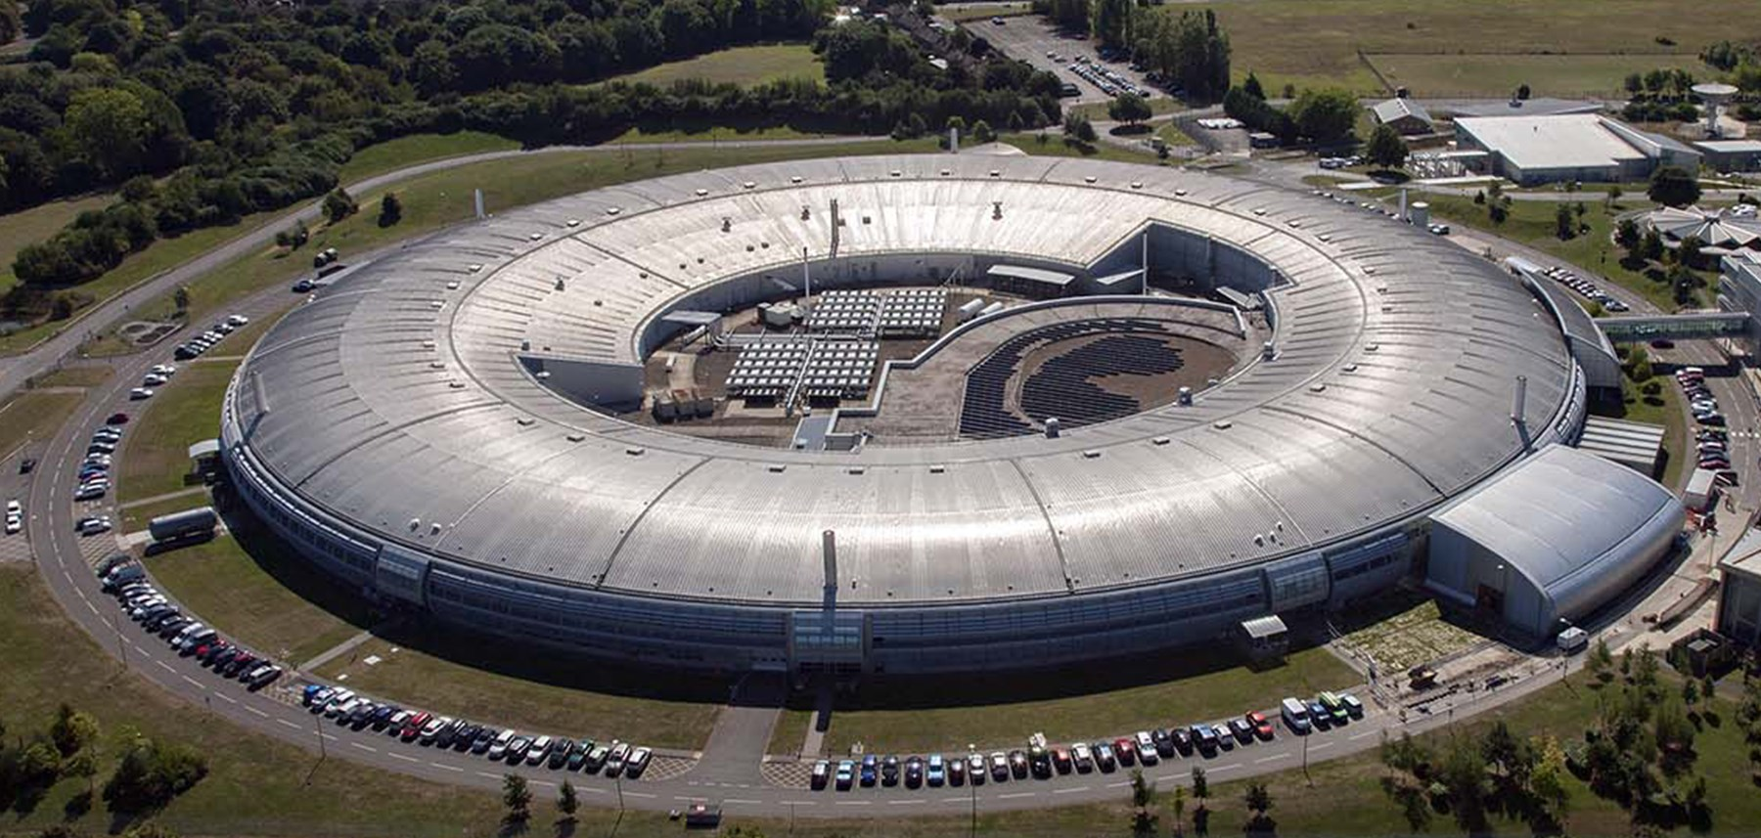

WEBSITES
•A Level Chemistry - https://alevelchemistry.co.uk/
•Details of the history of the best scientific discoveries - http://nobelprize.org
•10 weird and wonderful chemical reactions https://www.youtube.com/watch?v=0Bt6RPP2ANI
•Diamond Synchrotron in Oxfordshire - https://www.diamond.ac.uk/Home.html
•Chem NRICH maths: https://nrich.maths.org/6463
•Cambridge Chemistry Challenge: http://www.c3l6.org/
•Chemistry World Online: www.rsc.org/chemistryworld/
•RSC Journals: http://pubs.rsc.org/en/Journals?key=Title&value=Current
•Biochemical Society: www.biochemistry.org/
•Crash course videos
https://www.youtube.com/playlist?list=PL8dPuuaLjXtPHzzYuWy6fYEaX9mQQ8oGr
•SciShow on YouTube: https://www.youtube.com/user/scishow

Slide 11


EXPERIMENT
•Grow your own crystal e.g. salt http://www.sciencekids.co.nz/projects/saltcrystals.html
•Science Buddies: https://www.sciencebuddies.org/science-fair-projects/science-projects/chemistry/high-school
•Make a 'silver' egg http://www.housingaforest.com/silver-egg-experiment/
• Fizzics Education – Kitchen Chemistry Experiments: https://www.fizzicseducation.com.au/category/150-science-experiments/kitchen-chemistry-experiments/
•STEM Learning - Classic Chemistry Experiments: https://www.stem.org.uk/resources/collection/4035/classic-chemistry-experiments
•RSC Practical Resources: https://edu.rsc.org/resources/practical
•Creative Chemistry: https://www.creative-chemistry.org.uk/
•Create a Twitter account, follow 10 relevant Chemistry organisations e.g Royal Society of Chemistry, New scientist, BBC
Science news etc

Slide 12
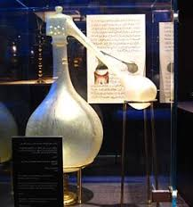
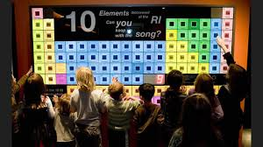
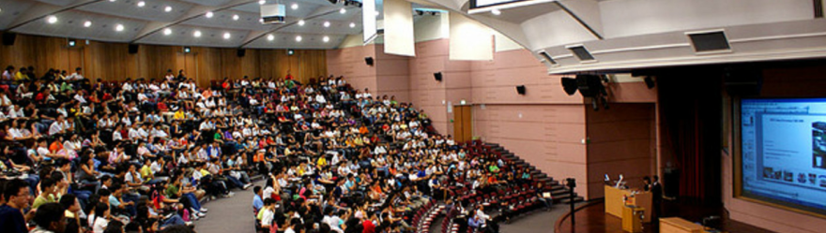
What else can I talk about?
You can also write about a chemistry lecture that you have attended, or about a recent visit to a science museum or exhibition (many museums’ websites offer virtual tours and plenty of useful information – for example, The Science Museum offers videos and tutorials on various chemistry topics, such as “How did X-ray crystallography transform science and our ability to ‘see’ atoms”).
These are all experiences that you can use and write about in your personal statement.

Slide 13


Online Courses
FutureLearn - Explore online courses to continue studying,
build professional skills and connect with experts.
Useful examples include:
How to Succeed at: Writing Applications
How to Succeed at: Interviews
OpenLearn - Open University? – These courses have been designed to increase confidence and develop the skills needed to enter Higher Education and succeed with learning.
The courses are free and they do not have a start and end date. You can start right away or at a time that suits you.
You can work through at your own pace
You can spend as long as you like on an OpenLearn course, plus, if you sign up you can track your progress and work towards a statement of participation.
There are around 1000 courses to choose from - https://www.open.edu/openlearn/free-courses/full-catalogue

Slide 14
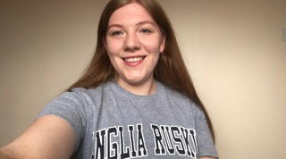
Personal advice
from those who made it!
“Use the time you have got to its full, but ensure you get a good balance of also looking after yourself and staying in touch with family and friends.
Plan ahead what you need to do and set deadlines to ensure you get them done.
To help prepare yourself for uni, do a little research around the course you’re about to do, read some published literature, this will really impress lecturers :)!”
Bethany Miller is currently studying BSc (Hons) Paramedic Science at Anglia Ruskin University

Slide 15

My HE+
Thinking about applying to University and looking for ways to explore your subject beyond the curriculum? Then this website is for you. Each topic is produced by Cambridge postgraduate students and academics at the cutting edge of research in their field. The topics provide guided activities, questions to think about and suggestions for further reading.
The main subject pages also give you a quick guide to what it would be like to study the subject at university level and suggest some further resources to check out.
https://www.myheplus.com/

Slide 16




Find Us Online:
www.TakeYourPlace.ac.uk
Cambs@TakeYourPlace.ac.uk
https://www.facebook.com/TakeYourPlaceHE
@TakeYourPlaceHE
@TakeCambs

