Slide 1
Data Protection Notice
The Network for East Anglian Collaborative Outreach (neaco) is a project aimed at increasing the number of young people going into Higher Education. neaco consists of the University of Cambridge (including its Colleges), Anglia Ruskin University, the University of East Anglia, Norwich University of the Arts, and the University of Suffolk.
Take Your Place is the programme which is being run by neaco in schools and colleges in East Anglia. Information about how your personal information will be used by us in connection with the administration of the Take Your Place programme, and for related purposes, is available at https://www.takeyourplace.ac.uk/how-we-use-participant-data.
We will also get in touch by email to facilitate your involvement in the Take Your Place programme. Please contact info@takeyourplace.ac.uk if you have any questions about how we use your data.
Explore your options,
Discover your potential
takeyourplace.ac.uk

Slide 2
Explore your options,
Discover your potential
Preparing for a Physics Application
takeyourplace.ac.uk

Slide 3
How can we help?
This PowerPoint is here to provide you with different ideas to support you with writing a Personal Statement for a physics course, as well as help you through the application process.
We have put together reading lists, preparation ideas and top tips for the application process for a physics course at University

Slide 4
Where do I start?!
Lets start with some reading. We recommend using this time to do some further reading on your chosen subject, as it is important that your personal statement contains an academic paragraph.

Slide 5
An Academic Paragraph
Having an academic paragraph in your personal statement is really important and we suggest using the following reading lists to help. You can use this paragraph to analyse a small piece of text from a relevant book/journal or an article.

Slide 6
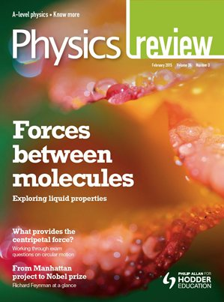
•BBC science and technology website: http://www.bbc.co.uk/science
•BBC news: http://www.bbc.co.uk/news/science_and_environment
•The Guardian - https://www.theguardian.com/science
•New Scientist: https://www.newscientist.com/
Physics journals
•Physics Review: https://www.hoddereducation.co.uk/physicsreview
•Physics World: https://physicsworld.com/
•New Scientist: https://www.newscientist.com/
•Scientific American: https://www.scientificamerican.com/
Reading Suggestions

Slide 7
Reading Suggestions
Books
•A Short History of Nearly Everything by Bill Bryson
•Surely You're Joking, Mr Feynman! by Richard Feynman
•Bad Science by Ben Goldacre
•The Grand Design by Stephen Hawkin and Leonard Mlodinow
•Newton by Peter Ackroyd
•The Quantum Universe: Everything that can happen does happen by Brian Cox and Jeff Forshaw
•Five Equations that changed the world by Michael Guillen
•Mathematical Methods for Physics and Engineering by K Riley, M Hobson & S Bence
•Fundamentals of Physics 6th Ed by Halliday, Resnick and Walker
•An introduction to Physical Geology by Davidson, Reed & David, Exploring Earth
•Sustainable Energy without the Hot air by David JC Mackay
•Engineering - A beginner’s guide by Natasha McCarthy
•Structures (or why things don't fall down) by J. E. Gordon

Slide 8
WATCH
•TED talks on https://www.ted.com/talks
•Khan Academy website for online lectures: https://www.khanacademy.org/science
•The Large Hadron Collider - https://home.cern/science/accelerators/large-hadron-collider
•Science Museum – Learning Resources: https://learning-resources.sciencemuseum.org.uk/resources/
•Royal Observatory Greenwich - https://www.rmg.co.uk/discover
RECOMMENDED FILMS:
•The Theory of Everything (2014), directed by James Marsh
•Einstein and Eddington (2008), directed by Philip Martin
•Infinity (1996), directed by Matthew Broderick
•The Abyss (1989), directed by James Cameron
•The Martian (2015), directed by Ridley Scott
•Gravity (2013), directed by Alfonso Cuarón

Slide 9
LISTEN
Radio programmes
•BBC Radio Cambridgeshire - The Naked Scientists http://www.bbc.co.uk/programmes/p001d7c7
•BBC Radio 4 - In our time http://www.bbc.co.uk/programmes/b006qykl/episodes/downloads:
CHECK OUT THESE PODCASTS:
The Naked Scientists: http://www.thenakedscientists.com/HTML/podcasts/
•University of Oxford Physics: https://podcasts.ox.ac.uk/units/department-physics
•Nature: http://www.nature.com/podcast/index.html
•Science: https://www.acs.org/content/acs/en/pressroom/podcasts.html

Slide 10
WEBSITES
•A Level Physics Online - https://www.alevelphysicsonline.com/
•Details of the history of the best scientific discoveries - http://nobelprize.org
•Podcasts, news and interviews with scientists about recent scientific developments - http://royalsociety.org
•The Large Hadron Collider - https://home.cern/science/accelerators/large-hadron-collider
•NASA TV (Online coverage of launches, missions and
testings) - https://www.nasa.gov/multimedia/nasatv#public
•Sixty Symbols – videos about the symbols of physics and astronomy - http://www.sixtysymbols.com/index.html
•Physics World - https://physicsworld.com/
•Crash course videos - https://www.youtube.com/playlist?list=PL8dPuuaLjXtN0ge7yDk_UA0ldZJdhwkoV
•Minute Physics - https://www.youtube.com/user/m
Inutephysics
•SciShow on YouTube: https://www.youtube.com/user/scishow

Slide 11
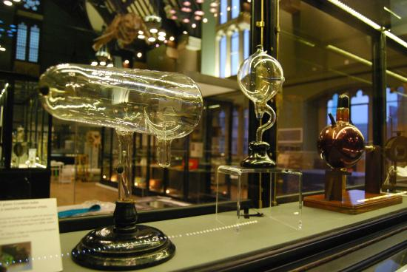
What else can I talk about?
You can also write about a physics lecture that you have attended, or about a recent visit to a science museum or exhibition (many museums’ websites offer virtual tours and plenty of useful information – for example, The Science Museum offers an unique VR experience on board the international space station-https://www.sciencemuseum.org.uk/see-and-do/space-descent-vr-tim-peake ).
These are all experiences that you can use and write about in your personal statement.

Slide 12
Online Courses
FutureLearn - Explore online courses to continue studying,
build professional skills and connect with experts.
Useful examples include:
How to Succeed at: Writing Applications
How to Succeed at: Interviews
OpenLearn - Open University? – These courses have been designed to increase confidence and develop the skills needed to enter Higher Education and succeed with learning.
The courses are free and they do not have a start and end date. You can start right away or at a time that suits you.
You can work through at your own pace
You can spend as long as you like on an OpenLearn course, plus, if you sign up you can track your progress and work towards a statement of participation.
There are around 1000 courses to choose from - https://www.open.edu/openlearn/free-courses/full-catalogue

Slide 13
Personal advice
from those who made it!
“Get ahead of the game. Once you know what degree you are going for and you have chosen the universities you are wanting to go to, then email the universities about more information. If you are looking at accommodation, then look at reviews of places and where is best to rent.
Also look into the key texts of your course, if you can get a hold of the lecturers’ emails and ask them who is best to read up on to get you ahead of the game. If you can’t get an email, then search up general books on your subject you can buy. Read through them and don’t be afraid to write in them - sometimes writing your thoughts on what the author is saying is a great way to remember and a good way to go back and reflect on what you thought at the time.
Most importantly, don’t forget to keep on top of the work you already have, it can be easy to get overwhelmed - aim to get it done before the deadlines, so you have less stress and enough time to look it over.
Kieran Hawkins is currently studying Sociology and Criminology (BA) as a joint honours degree at Anglia Ruskin University

Slide 14
My HE+
Thinking about applying to University and looking for ways to explore your subject beyond the curriculum? Then this website is for you. Each topic is produced by Cambridge postgraduate students and academics at the cutting edge of research in their field. The topics provide guided activities, questions to think about and suggestions for further reading.
The main subject pages also give you a quick guide to what it would be like to study the subject at university level and suggest some further resources to check out.
https://www.myheplus.com/

Slide 15
Find Us Online:
www.TakeYourPlace.ac.uk
Cambs@TakeYourPlace.ac.uk
https://www.facebook.com/TakeYourPlaceHE
@TakeYourPlaceHE
@TakeCambs

