Slide 1
Data Protection Notice
The Network for East Anglian Collaborative Outreach (neaco) is a project aimed at increasing the number of young people going into Higher Education. neaco consists of the University of Cambridge (including its Colleges), Anglia Ruskin University, the University of East Anglia, Norwich University of the Arts, and the University of Suffolk.
Take Your Place is the programme which is being run by neaco in schools and colleges in East Anglia. Information about how your personal information will be used by us in connection with the administration of the Take Your Place programme, and for related purposes, is available at https://www.takeyourplace.ac.uk/how-we-use-participant-data.
We will also get in touch by email to facilitate your involvement in the Take Your Place programme. Please contact info@takeyourplace.ac.uk if you have any questions about how we use your data.
Explore your options,
Discover your potential
takeyourplace.ac.uk

Slide 2
Explore your options,
Discover your potential
Preparing for a Psychology Application
takeyourplace.ac.uk

Slide 3
How can we help?
This PowerPoint is here to provide you with different ideas to support you with writing a Personal Statement for a psychology course, as well as help you through the application process.
We have put together reading lists, preparation ideas and top tips for the application process for a psychology course at University

Slide 4
Where do I start?!
Lets start with some reading. We recommend using this time to do some further reading on your chosen subject, as it is important that your personal statement contains an academic paragraph.

Slide 5
An Academic Paragraph
Having an academic paragraph in your personal statement is really important and we suggest using the following reading lists to help. You can use this paragraph to analyse a small piece of text from a relevant book/journal or an article.

Slide 6
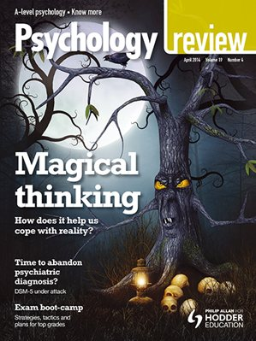
Reading Suggestions
•Psychology Review (Hodder Education: available in print and digital format)
•PsychMag website and Twitter (@PsychMag): www.psychmag.com
•British Psychological Society: www.bps.org.uk
•The Psychologist Journal: www.thepsychologist.org.uk
To explore aspects of Psychology more deeply in a concise volume,
some of the Very Short Introduction series from OUP are worth
reading:
•Psychology by Gillian Butler and Freda McManus
•The Brain by Michael O'Shea
•Child Psychology by Usha Goswami
•Consciousness by Susan Blackmore
•Forensic Psychology by David Canter

Slide 7
Further Reading Suggestions
•The Man Who Mistook His Wife for a Hat by Oliver Sacks
•Mindset by Dr. Carol Dwek
•The Private Life of the Brain by S. Greenfield
•Freud by Anthony Storr
•Phantoms in the Brain: Human Nature and the Architecture of the Mind by
V.S.Ramachandran & S.Blakeslee
•Memory by Jonathan K Foster
•Consciousness Explained by D.C.Dennett
•Psychoanalysis by Daniel Pick
•Schizophrenia by Chris Frith and Eve C. Johnstone
•Sleep by Steven W. Lockley and Russell G. Foster
•Social Psychology by Richard J Crisp
•Nature via Nurture: Genes, experience and what makes us human by M.Ridley
•Adolescence by Peter K Smith
•Anxiety by Daniel Freeman and Jason Freeman
•Bounce by Matthew Syed
•Flow by Mihaly Csikszentmihalyi
•Thinking Fast and Slow by Daniel Kahneman
•Authentic Happiness by Martin Seligman

Slide 8
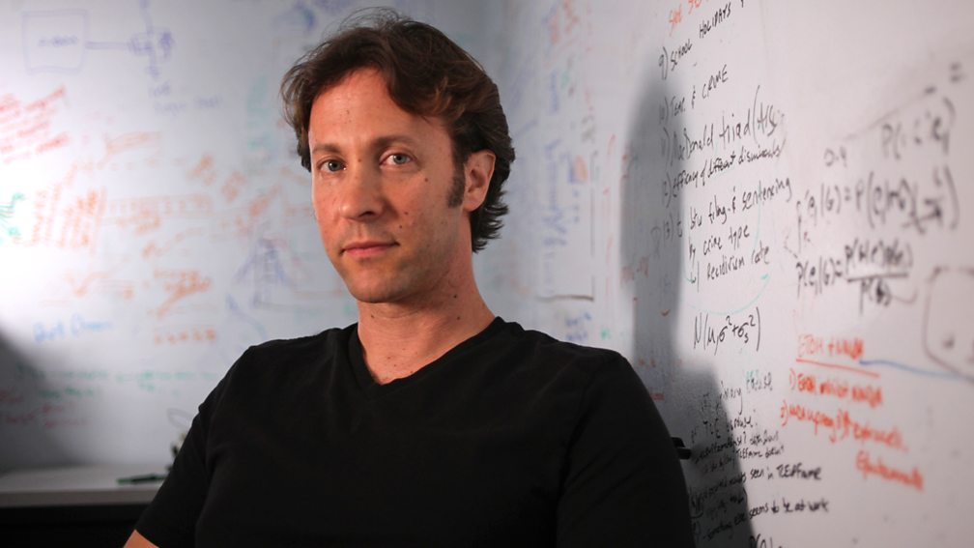
WATCH
To explore Cognitive and BioPsychology:
•The Brain with David Eagleman - https://www.bbc.co.uk/programmes/b06yjrdp
•The Aviator (2005), directed by Martin Scorsese
•Memento (2000), directed by Christopher Nolan
•Good Will Hunting (1997), directed by Gus Van Sant
•Rain Man (1989), directed by Barry Levinson
To consider social influence in practice (especially minority influence):
Suffragette, directed by Sarah Gavron
Twelve Angry Men, directed by Sidney Lumet
The Stanford Prison Experiment, directed by K. Patrick Alvarez

Slide 9
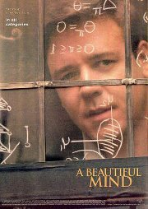
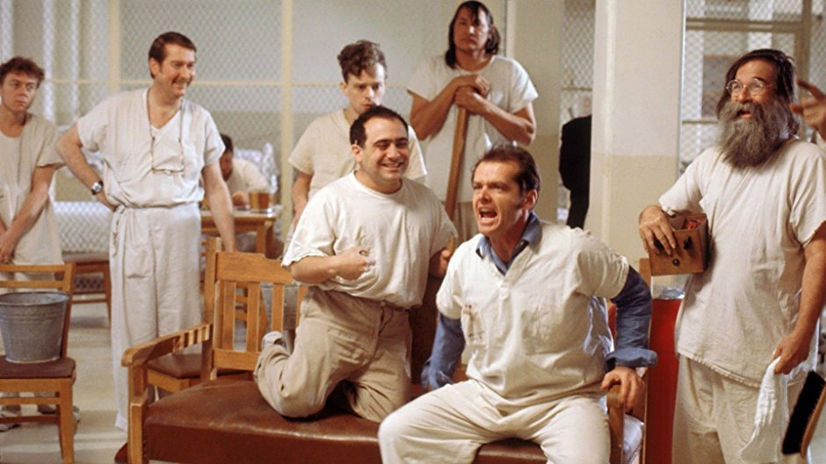
WATCH
For insights into Psychopathology:
•A Beautiful Mind (2001), directed by Ron Howard
•One Flew Over A Cuckoo’s Nest (1975), directed by Miloš Forman
•The Imitation Game (2014), directed by Morten Tyldum
•Shutter Island (2010), directed by Martin Scorsese
•The Joker (2019), directed by Todd Phillips
•American Psycho (2000), directed by Mary Harron
For fun
•The Big Bang Theory - American sitcom with some astute Psychology
General
•TED talks from the Royal Society of Arts: https://www.ted.com/talks

Slide 10
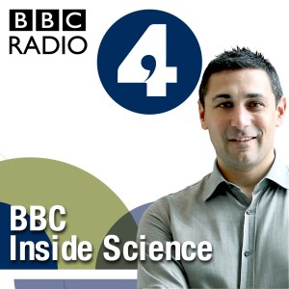
LISTEN
CHECK OUT THESE PODCASTS:
All in the Mind: broadcast on Radio 4
All in the Mind (many archived editions):
http://www.bbc.co.uk/programmes/b006qxx9/episodes/player
Inside Science broadcast on BBC Radio 4
Inside Science (many archived editions): http://www.bbc.co.uk/programmes/b036f7w2/episodes/player
Mind Changers on BBC Radio 4 https://www.bbc.co.uk/programmes/b008cy1j

Slide 11
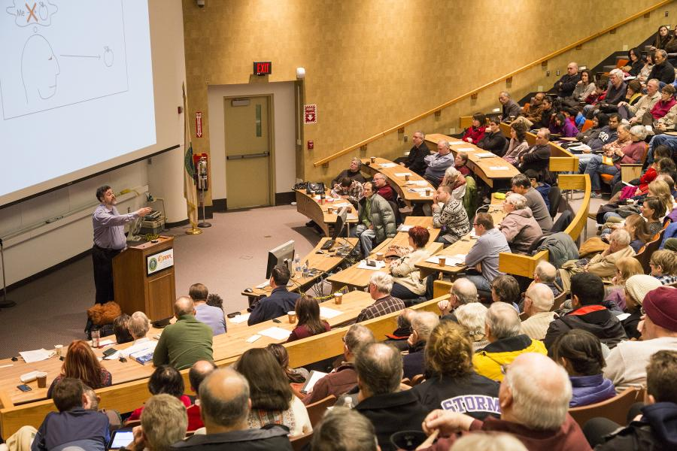
What else can I talk about?
You can also write about a psychology lecture, visit to a science museum or an exhibition that you have seen yourself in your personal statement. Maybe you have seen how a counselling psychologist works or you have attended a StressLess session at school? These are all experiences that you can use and write about in your personal statement.

Slide 12
Online Courses
FutureLearn - Explore online courses to continue studying,
build professional skills and connect with experts.
Useful examples include:
How to Succeed at: Writing Applications
How to Succeed at: Interviews
OpenLearn - Open University? – These courses have been designed to increase confidence and develop the skills needed to enter Higher Education and succeed with learning.
The courses are free and they do not have a start and end date. You can start right away or at a time that suits you.
You can work through at your own pace
You can spend as long as you like on an OpenLearn course, plus, if you sign up you can track your progress and work towards a statement of participation.
There are around 1000 courses to choose from - https://www.open.edu/openlearn/free-courses/full-catalogue

Slide 13
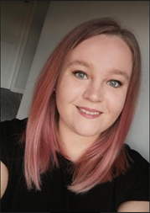
Personal advice
from those who made it!
“Keep on top of your schoolwork, use this time to research universities and courses and make a start on your personal statement ready in time for UCAS to open in September. Most of all, DON'T STRESS! There are lots of routes into university, be kind to yourself!”
Amy Felton is currently studying BSc Psychology with Clinical Psychology at Anglia Ruskin University

Slide 14
My HE+
Thinking about applying to University and looking for ways to explore your subject beyond the curriculum? Then this website is for you. Each topic is produced by Cambridge postgraduate students and academics at the cutting edge of research in their field. The topics provide guided activities, questions to think about and suggestions for further reading.
The main subject pages also give you a quick guide to what it would be like to study the subject at university level and suggest some further resources to check out.
https://www.myheplus.com/

Slide 15
Find Us Online:
www.TakeYourPlace.ac.uk
Cambs@TakeYourPlace.ac.uk
https://www.facebook.com/TakeYourPlaceHE
@TakeYourPlaceHE
@TakeCambs

