Slide 1
Data Protection Notice
The Network for East Anglian Collaborative Outreach (neaco) is a project aimed at increasing the number of young people going into Higher Education. neaco consists of the University of Cambridge (including its Colleges), Anglia Ruskin University, the University of East Anglia, Norwich University of the Arts, and the University of Suffolk.
Take Your Place is the programme which is being run by neaco in schools and colleges in East Anglia. Information about how your personal information will be used by us in connection with the administration of the Take Your Place programme, and for related purposes, is available at https://www.takeyourplace.ac.uk/how-we-use-participant-data.
We will also get in touch by email to facilitate your involvement in the Take Your Place programme. Please contact info@takeyourplace.ac.uk if you have any questions about how we use your data.
Explore your options,
Discover your potential
takeyourplace.ac.uk

Slide 2
Explore your options,
Discover your potential
Helpful resources for anyone interested in studying Law at University.
takeyourplace.ac.uk

Slide 3
How can we help?
This PowerPoint is here to provide you with different ideas to help and support you with writing a Personal Statement for a Law course at University.
We have put together reading lists, preparation ideas and top tips for the application process for university.
You might not be able to do any practical work experience before you apply to university, but you can gain an insight into Law in lots of other ways.

Slide 4
Where do I start?!
Lets start with some reading. We recommend using this time to do some further reading on your chosen subject, as it is important that your personal statement contains an academic paragraph.

Slide 5
An Academic Paragraph
Having an academic paragraph in your personal statement is really important and we suggest using the following reading lists to help. You can use this paragraph to analyse a small piece of text from a relevant book/journal, article or performance.

Slide 6
Reading suggestions
About Law – Tony Honoré
Landmarks in the Law – Lord Denning
Letters to a Law Student – Nicholas McBride
Bleak House – Charles Dickens
Learning the Law – Glanville Williams
To Kill a Mockingbird – Harper Lee
Jeremy Hutchinson’s Case Histories – Thomas Grant
Winning Arguments – Jay Heinrichs
Lord Denning, A Life – Iris Freeman
On Liberty – John Stuart Mill

Slide 7
Newspapers and Journals
The following newspapers have specific sections for legal news:
The Independent
The Daily Telegraph
The Guardian (Follow them on Twitter: @GdnLaw)
All About Law - https://www.allaboutlaw.co.uk/
https://www.newlawjournal.co.uk/

Slide 8
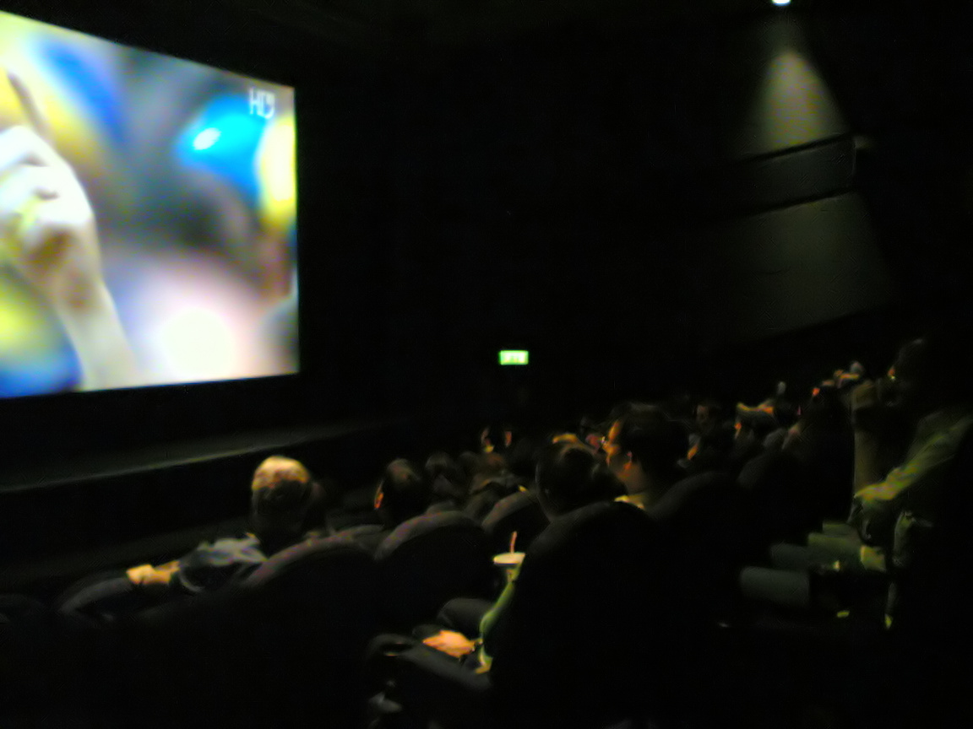
Film & Documentary suggestions
Try these movies and documentaries which might provide inspiration for further study:
On the Basis of Sex is a biopic based on the life of Supreme Court Justice Ruth Bader Ginsburg.
The Client - depicts one of the less-dramatized areas of law: dependency law.
Hot Coffee – documentary which features the now famous Liebeck v. McDonald’s case.
The Legal World, BBC documentary https://www.bbc.co.uk/programmes/p0099v89

Slide 9
Other ways to get inspired about Law
The Guardian website have published "Law: a student guide" with interesting articles about what to expect whilst studying law at university:
The Student Lawyer is a free online resource that brings together legal news and articles in an accessible format for future lawyers. The site is written by law students or practising professionals and is intended for law students of all levels.
The Twitter feed of the New Weekly Law Journal: @newlawjournal

Slide 10
More inspiration
There are several legal blogs that you may find interesting, including:
University of Leicester Law Blog - written by current students.
The blog of Leicester Law School graduate Philip Henson, who is now a partner and Head of Employment Law at an award-winning London Law firm. He is regularly quoted as an expert in employment law in the national, international and HR media; including several appearances on BBC News 24, BBC Radio, ITN News and Sky News.
Two blogs focusing on legal issues in the UK: Law and Lawyers and Charon QC.
Law Actually, the blog of an in-house lawyer from the telecoms industry.

Slide 11
Make the most of now
We are living through History!
The coronavirus is already having and will continue to have an impact in legal terms with police being given new powers to ensure people follow restrictions.
Keep a Law focused diary of the events as they happen. Take note of new laws which are introduced during this time and how these are implemented.

Slide 12
Find Us Online:
www.TakeYourPlace.ac.uk
Cambs@TakeYourPlace.ac.uk
https://www.facebook.com/TakeYourPlaceHE
@TakeYourPlaceHE
@TakeCambs

Slide 13
My HE+
Thinking about applying to University and looking for ways to explore your subject beyond the curriculum? Then this website is for you. Each topic is produced by Cambridge postgraduate students and academics at the cutting edge of research in their field. The topics provide guided activities, questions to think about and suggestions for further reading.
The main subject pages also give you a quick guide to what it would be like to study the subject at university level and suggest some further resources to check out.
https://www.myheplus.com/

